Slide 1
COMP5423 Natural Language Processing

Slide 2
Introduction to Natural Language Process (Part 2)

Slide 3
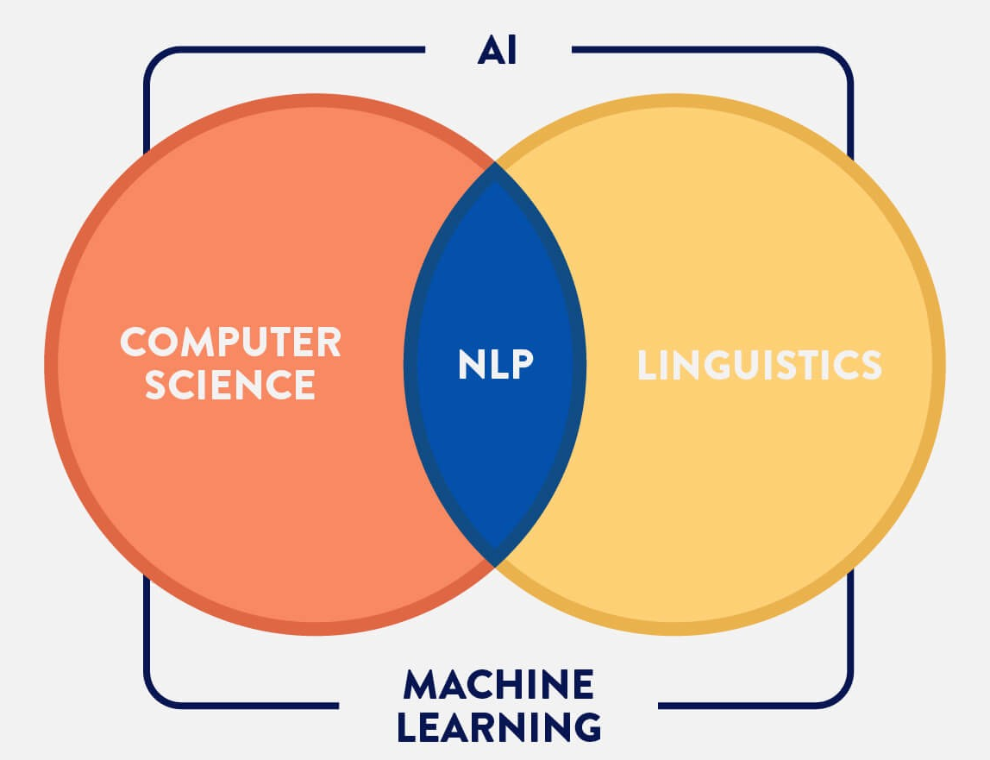
Introduction to NLP
Technologies for NLP
NLP is also known
as computational
linguistics (CL).
Natural Language Processing (NLP) is a interdisciplinary field of linguistics, computer science and artificial intelligence, concerned with the interactions between computers and human language. [Wikipedia]
Notes:
ACL: Association for Computational Linguistic

Slide 4
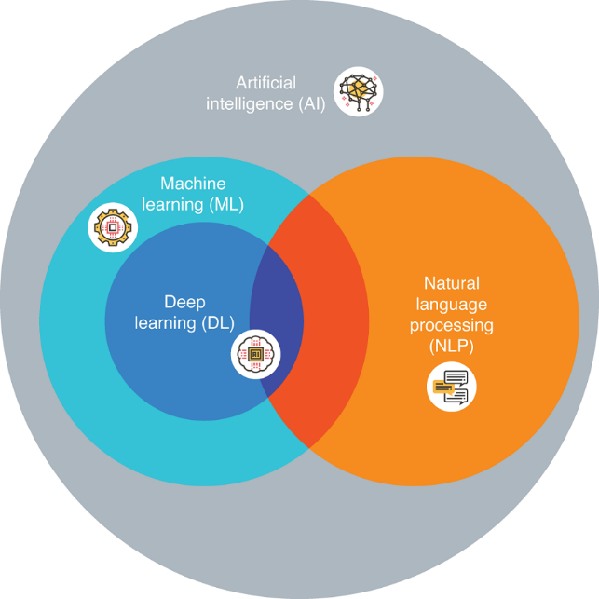
Introduction to NLP
Technologies for NLP
Artificial intelligence (AI) refers to the simulation of human intelligence in machines that are programmed to think and act like humans.
Natural Language Processing (NLP) is a subfield of AI which has close ties with Machine Learning.
Cognitive scientists have long debated whether language and cognition are separate mental faculties, or whether language emerges from general cognitive abilities.
Notes:
AI with a broader vision
Language and Cognition
Catherine L Harris, Boston University, Massachusetts, USA
Cognitive scientists have long debated whether language and cognition are separate mental faculties, or whether language emerges from general cognitive abilities.
认知科学与人工智能有一定的交集，但它们是不同的学科。认知科学是一个跨学科的领域，研究心智和智能的本质，包括心理学、神经科学、语言学、哲学、人类学和计算机科学等多个学科。它关注的是理解人类和动物的认知过程，如感知、记忆、推理和语言。
Hinton and Chomsky fight against each other.

Slide 5
Introduction to NLP
Technologies for NLP
Text Classification
News Categorization
Entity Relation Classification
Sentiment, Emotion Classification
Email Spam, Fake News, Rumor Detection
Text Ranking
Information Retrieval
Extractive Summarization
Retrieval-based Response Generation

Slide 6
Introduction to NLP
Technologies for NLP
Text Sequence Labeling
Part-of-Speech Tagging
Semantic Role Labelling
Named Entity Extraction
Sequence-to-Sequence Text Generation
Machine Translation
Response Generation
Abstractive Summarization
Syntactic, Semantic, Discourse Parsing
Notes:
Finding an efficient parser is a nontrivial problem and a great deal of research has been conducted on parser design. Two basic approaches to parsing are top-down parsing and bottom-up parsing.
Chart parsing
A shift-reduce parser is a class of efficient, table-driven bottom-up parsing methods
Parsing: Shift – Reduce

Slide 7
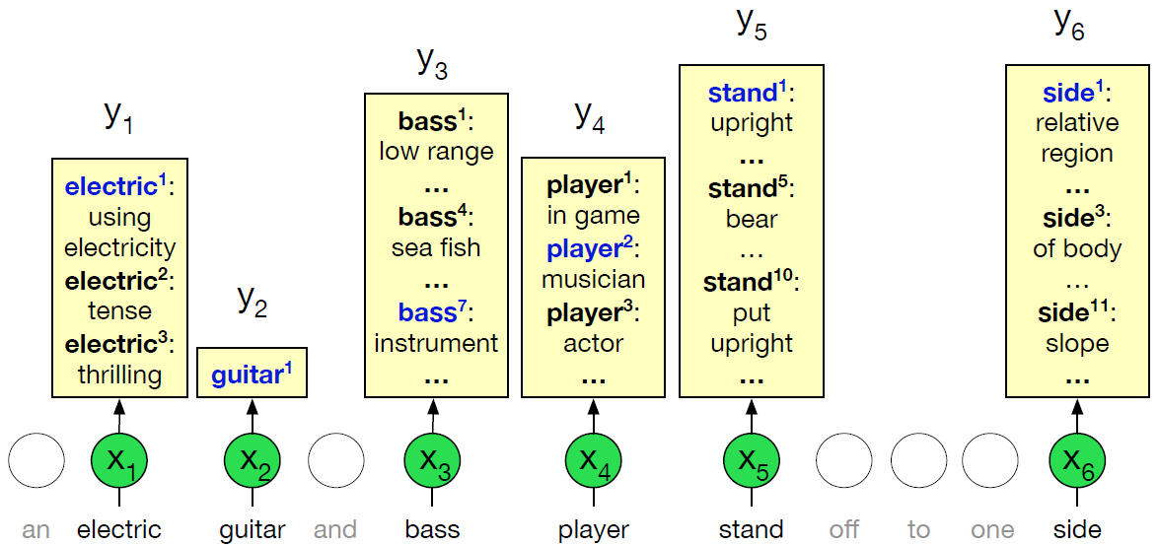
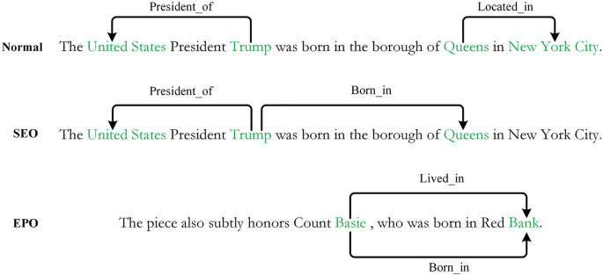
Introduction to NLP
Text Classification
Fundamental NLP Tasks
NLP Application Tasks
Sentence Boundary Detection
Sense Disambiguation
Sentiment/Emotion Classification
Email Spam Classification
Fake News Classification
News Categorization
Entity Type Classification
Relation Extraction
Features: (Context) Word, POS, Word Shapes (e.g.., Xx, x), Phrase (NE) Types, Syntactic Path, Lexicon ….
Classifiers: Naïve Bayes, Decision Tree, Random Forests, SVM, Logistic Regression, RNN, CNN, BERT, ….
Notes:
borough US [ˈbɜroʊ]
Random Forests: ensemble learning

Slide 8
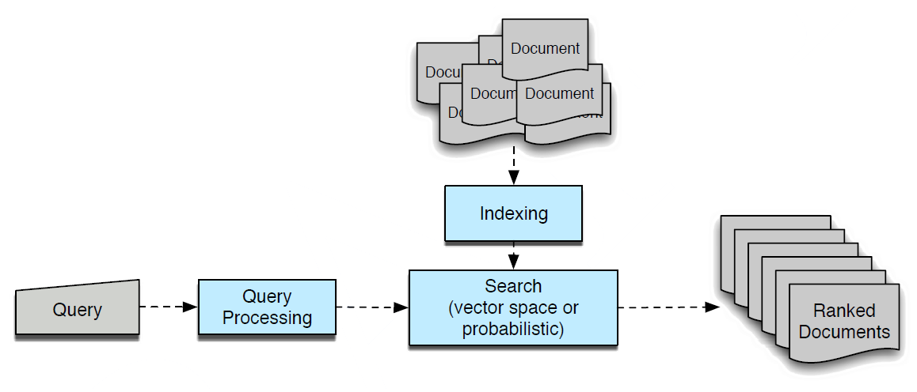

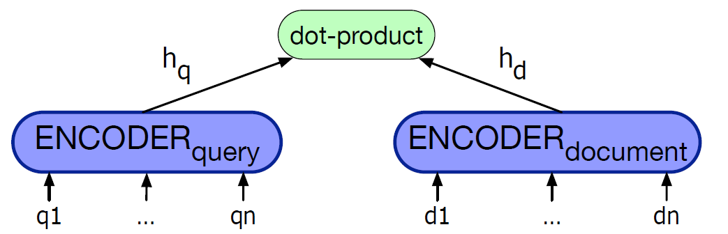
Introduction to NLP
Text Ranking
NLP Application Tasks
Information Retrieval
Extractive Summarization
Retrieval-based Response Generation
Document
User turn q
Search
Turn 1: Utterance 1
Turn 2: Utterance 2
Turn 3: Utterance 3
Turn 4: Utterance 4
Turn 5: Utterance 5
Turn 6: Utterance 6
…..
User
System
Documents
Preprocessing
Response r
(Utterance 4)
Feature Selection
Retrieved
Passages
Retrieve
Most Similar Turn t
Sentence Selection
and Ordering
Summary
Summary
Features: Word, Position,….
Retrieval Models: Vector Space Model, Probabilistic Retrieval Model, Language Model, Dense Retrieval Model

Slide 9
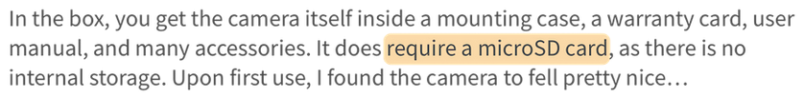
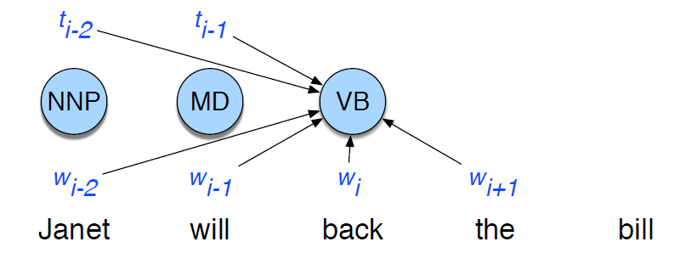
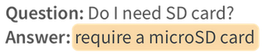
Introduction to NLP
Sequence Labeling
Fundamental NLP Tasks
NLP Application Tasks
Par-of-Speech Tagging
Named Entity Tagging
(BIO Annotation Scheme)
Answer Extraction
Donald | Trump | was | a | president | of | USA
B-PER | I-PER | O | O | O | O | B-LOC
Donald | Trump | was | a | president | of | USA
Noun | Noun | Verb | Article | Noun | PREPOS | Noun
Features: (Previous) Word, POS, Word Shapes (e.g.., Xx, -), Prefix, Suffix, ….
Sequential Classifiers: HMM, Conditional Random Fields (CRF), RNN, BERT, …

Slide 10
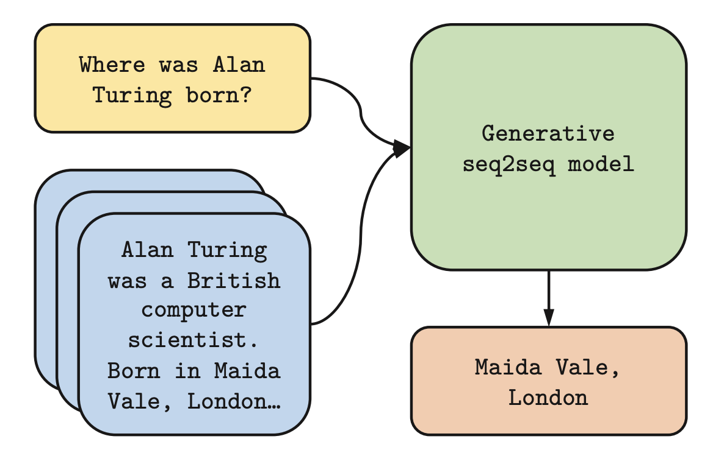
Introduction to NLP
Sequence-to-Sequence Generation
NLP Application Tasks
Machine Translation
Abstractive Summarization
Response Generation
Answer Generation
Retrieval-Augmented Generation
Sequence-to-Sequence Models: BART, T5, …

Slide 11
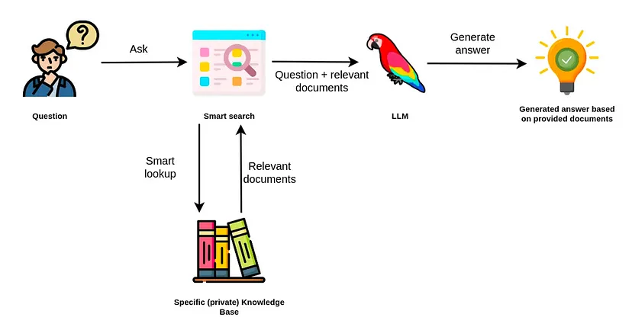
Introduction to NLP
Sequence-to-Sequence Generation
Retriever
Generator
Retrieval-Augmented Generation (RAG)
Notes:
reduce hallucination [həˌluːsɪˈneɪʃ(ə)n]

Slide 12
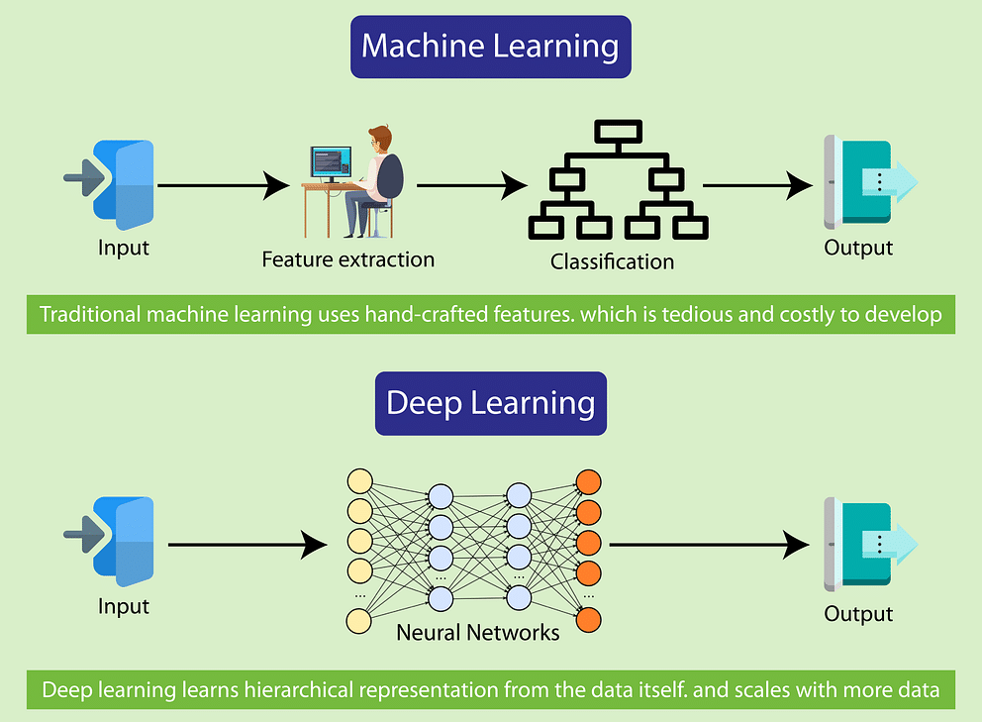



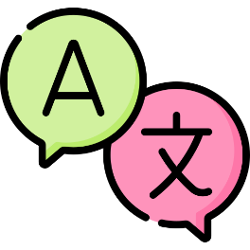

Introduction to NLP
Technologies for NLP
From Machine Learning to Deep Learning

Slide 13


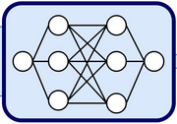


Introduction to NLP
Technologies for NLP
From Pre-Trained Language Models to Large Language Models
Notes:
It is getting more and more like the human brain.

Slide 14
Introduction to NLP
History of NLP
Phase 1: Symbolic NLP (1950s – 1990s)
Models of Grammars (Syntactics)
Logical Form (Semantics and Reasoning)
(Linguistic) Rule-based Approaches
Phase 2: Statistical NLP (1990s – 2010s)
Machine Learning based Approaches (Supervised)
Feature Engineering
Notes:
Design task-specific features.

Slide 15
Introduction to NLP
History of NLP
Phase 3: Neural NLP (2010s – Present)
Neural Network Models
Deep Learning based Approaches
Representation Learning (Self-Supervised)

Slide 16
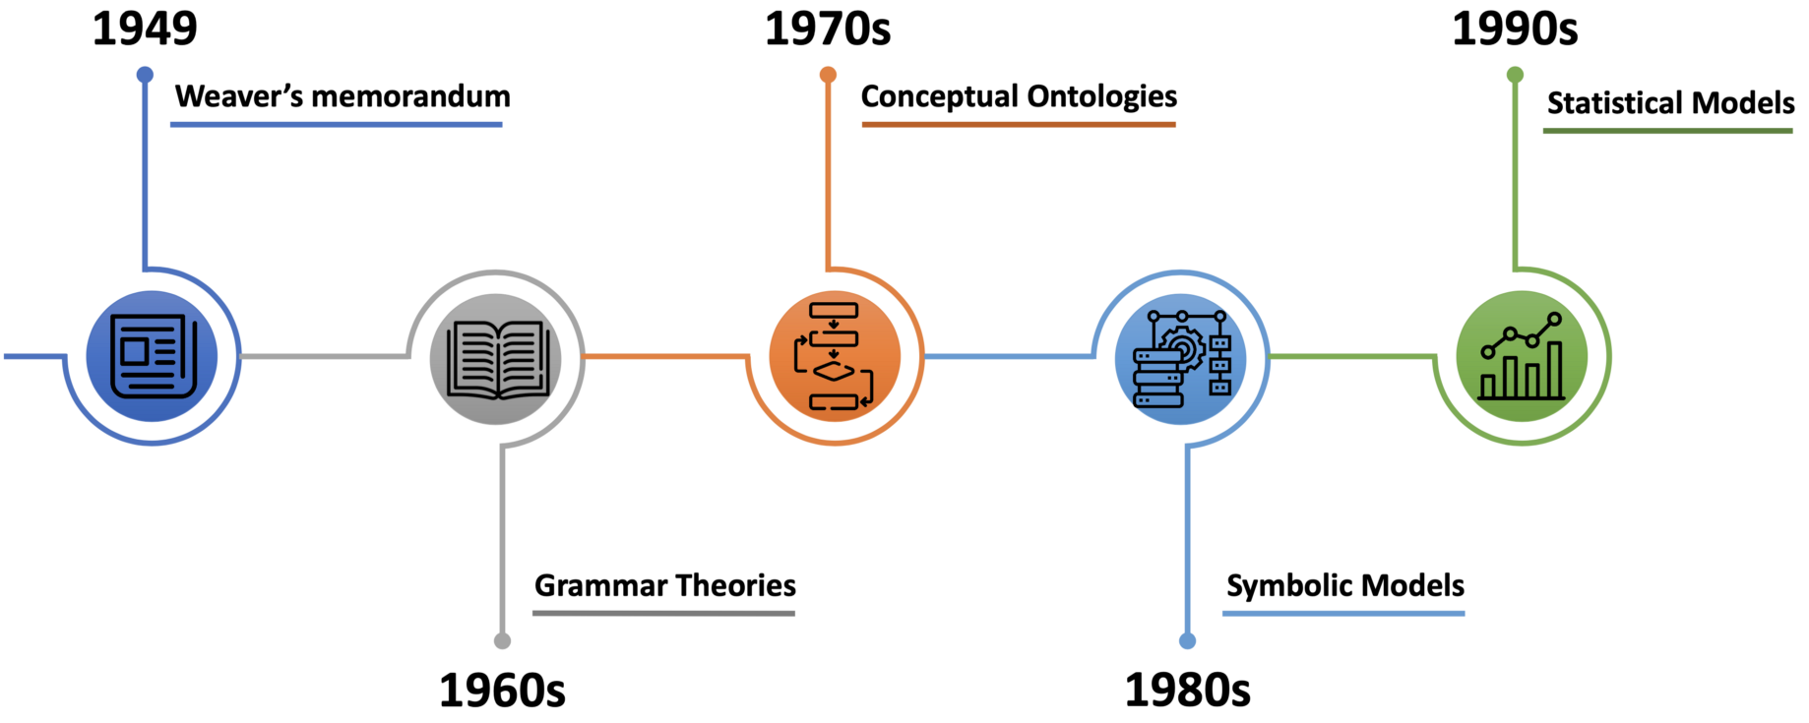
Introduction to NLP
History of NLP
Semantic Networks
Conceptual Network
Bag-of-Word
N-Gram Language Model
Machine Translation
1949: Weaver’s Memorandum
1954: Georgetown-IBM Experiment (Russian to English)
Turning Test
1950: Computing Machinery and Intelligence
Syntactic Structure
1957: Norm Chomsky’s Generative Grammar
(Phrase-Structure Grammar)
ELIZA
1964: A Computer Psychotherapist (The First Chatbot)
Notes:
memorandum: [.memə'rændəm]
Phase 1: Linguistic Analysis
The earliest research in natural language processing was machine translation. Weaver first proposed the idea of machine translation in 1949 after World War II. 1954 was the year when automatic translation of about 60 sentences from Russian to English was demonstrated in the Georgetown-IBM experiment. In the 1960s, large-scale research on machine translation was conducted abroad, which cost a huge amount of money. However, people obviously underestimated the complexity of natural language at that time, so little progress was made. In 1966, the ALPAC released a report that concluded that MT was not immediately achievable and recommended the research community to stop funding it.
In 1950, Alan Turing proposed the famous “Turing Test” in his article “Computing Machinery and Intelligence” as a criterion of intelligence. The Turing test examined the ability for machines to exhibit intelligent behavior equivalent to that of humans, which is generally considered to be the beginning of natural language processing.
In 1957, Noam Chomsky published his book “Syntactic Structures”, which highlighted the importance of sentence syntax in language understanding. The invention of the “Phrase-Structure Grammar” played an important role in that era. After that, more Grammar Theories that were computationally tractable were developed.
Eliza was built to replicate the conversation between a psychologist and a patient. It was actually the first chatbot built based on pattern matching and transformation rules. ELIZA (the first chatbot) had a great influence not only in NLP but in the entire field of AI.
The 1970s brought new ideas into NLP, such as building Conceptual Ontologies which structured real-world information into computer-understandable data.
From the 1950s to the 1990s, NLP mainly adopted rule-based approaches. Researchers believed that the process of natural language processing is similar to the process of human beings when learning a language, so a large number of researchers conduct research based on linguistic rules to establish vocabulary, syntax and semantic analysis, question and answer, chat and machine translation systems. However, the rule-based approaches have unavoidable shortcomings. First, the rules cannot cover all sentences. Secondly, these approaches have extremely high requirements for developers. Developers must not only be proficient in computers but also proficient in linguistics.
Key Aspects of Natural Language Processing with Symbolic AI
Text Preprocessing and Tokenization
Parsing and Syntactic Analysis
Semantic Analysis and Meaning Extraction

Slide 17
Introduction to NLP
History of NLP
Semantic Networks
Conceptual Network
Bag-of-Word
N-Gram Language Model
Machine Translation
1949: Weaver’s Memorandum
1954: Georgetown-IBM Experiment (Russian to English)
Turning Test
1950: Computing Machinery and Intelligence
Syntactic Structure
1957: Norm Chomsky’s Generative Grammar
(Phrase-Structure Grammar)
ELIZA
1964: A Computer Psychotherapist (The First Chatbot)
Notes:
Phase 2: Computational Linguistics
Since late 1980s and early 1990s, the statistical data-driven approaches became popular, replacing most natural language processing systems based on complex sets of hand-written rules. This progress was the result of both the steady increase of computational power, and the shift to machine learning algorithms. At the time, these statistical models were capable of making soft, probabilistic decisions, becoming mainstream approaches.
One of the simplest approaches to NLP, known as bag-of-words, leverages the number of occurrences of each word as features for text classification, text ranking (information retrieval). N-gram model was a statistical language model, which is the father of modern neural language models.

Slide 18
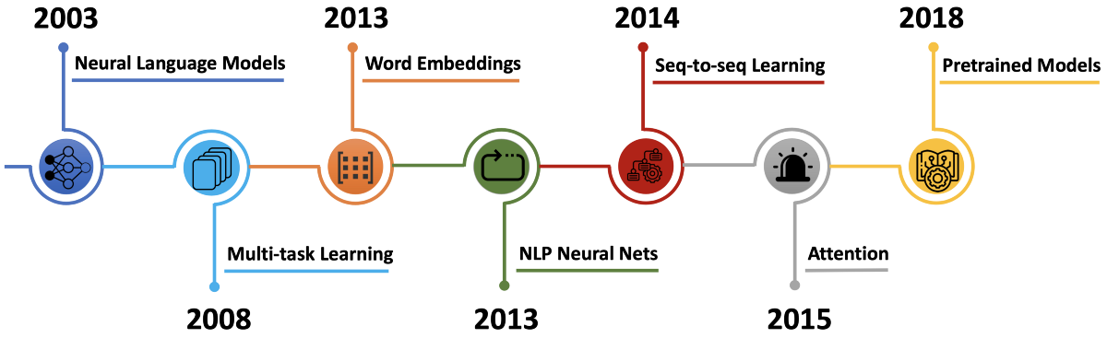
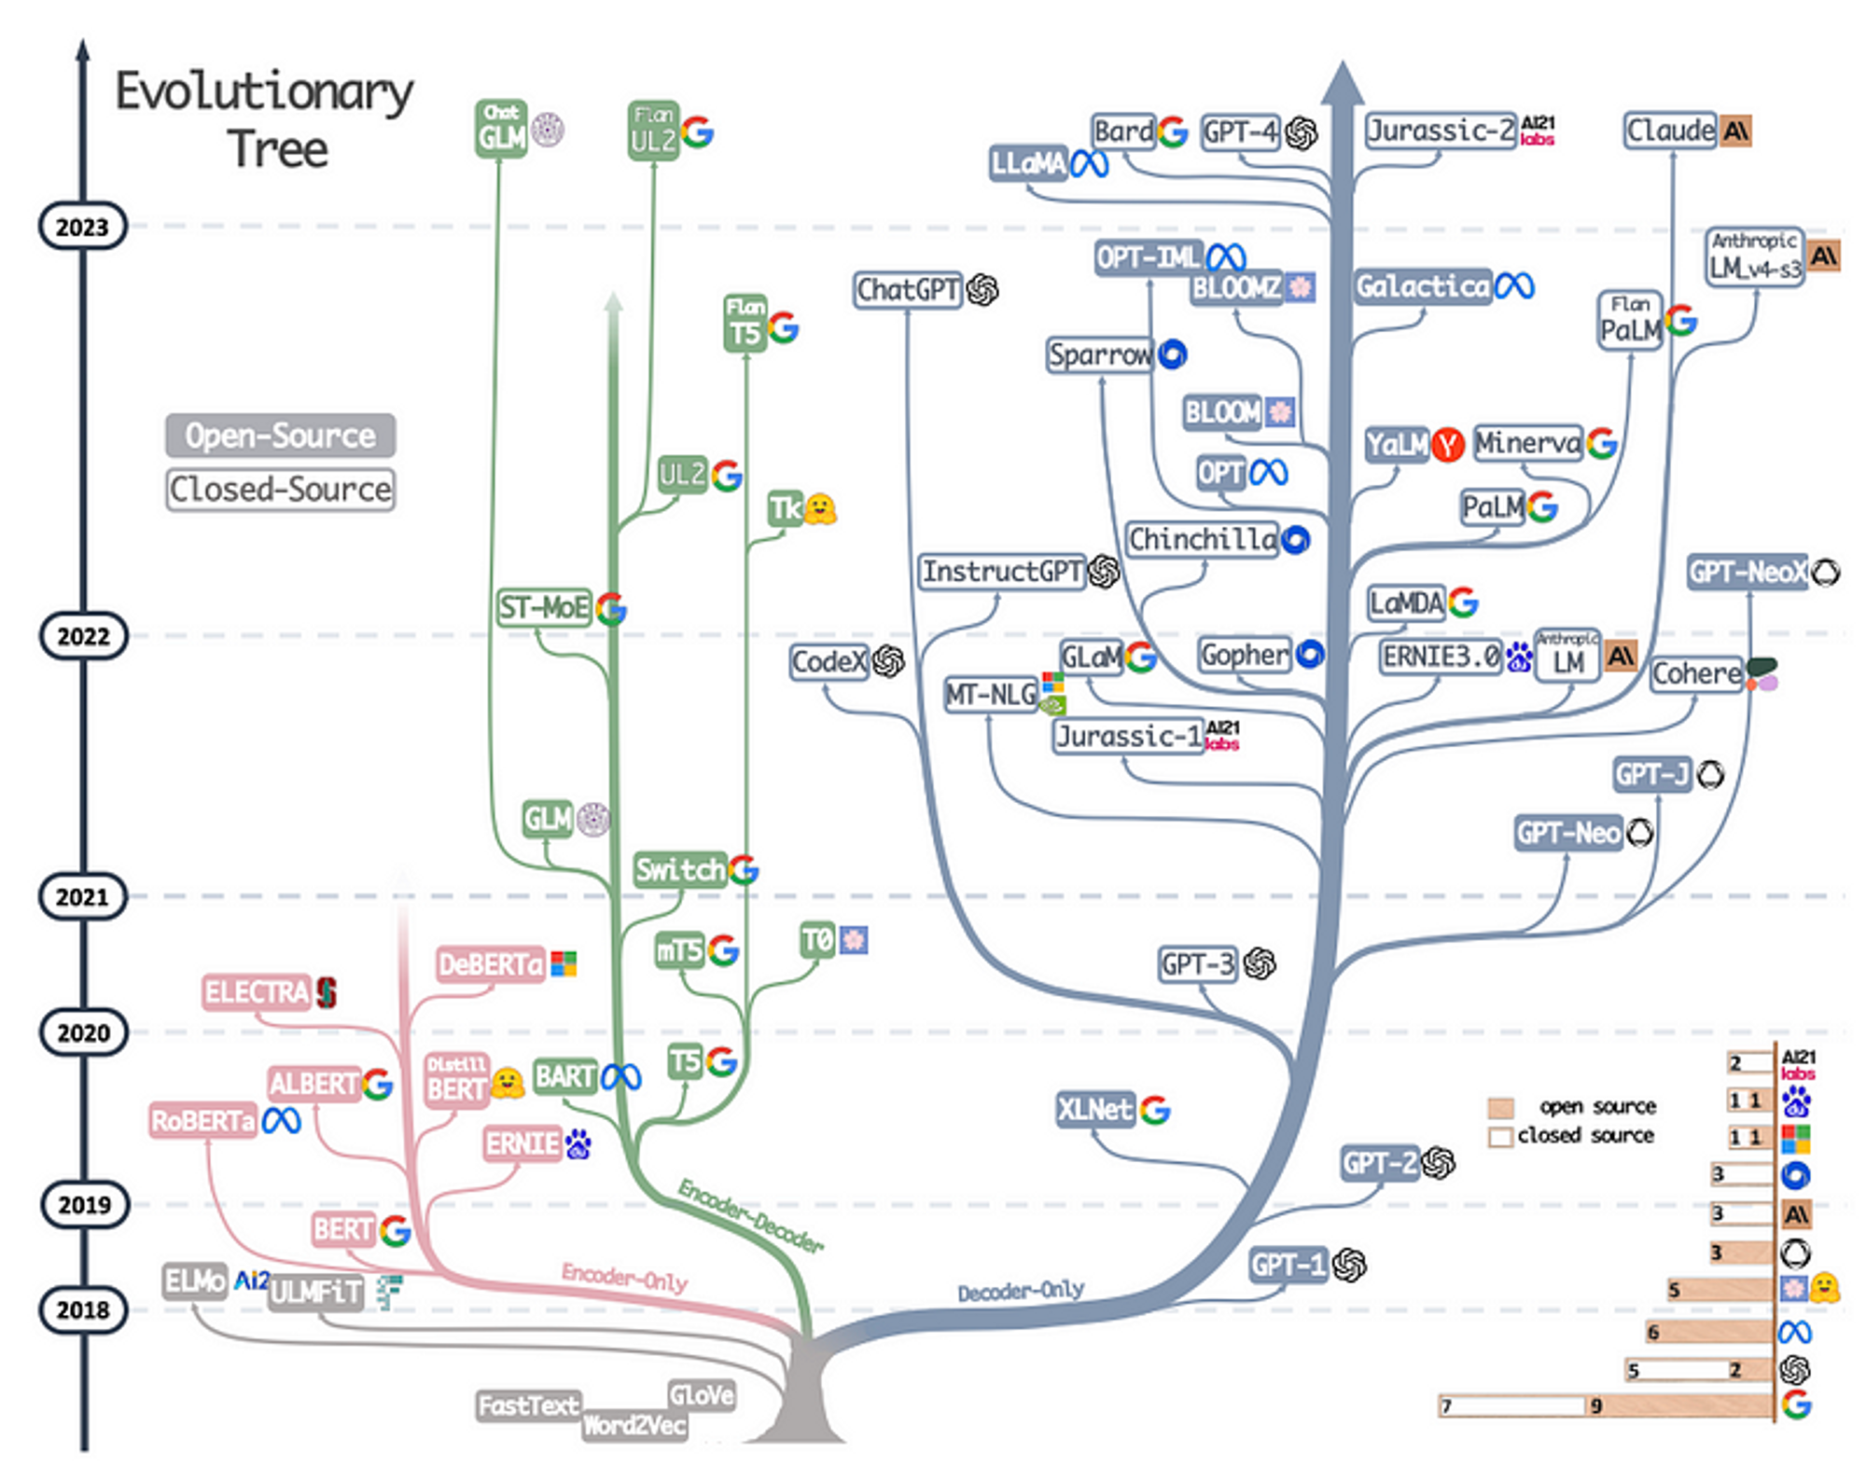
Introduction to NLP
History of NLP
2022
Neural Language Model
2003: Feed-forward Neural Network and Word Embeddings
Pre-Trained Language Models
Transformer (Encoder-Decoder)
BERT (Encoder)
GPT (Decoder)
Word Embeddings
2013: Word-to-Vector (CBOW and Skip-Gram)
2023: Test of Time Award in NeurIPS
Sequence-to-Sequence Learning
2014: End-to-End Machine Translation, Summarization and Conversation Models
Multi-Task Learning (Joint Learning)
2018: Test-of-time Award in ICML
Neural Network Models
Recurrent Neural Network (RNN, LSTM and GRU)
Convolutional Neural Network (CNN)
Recursive Neural Network
Attention
Alleviate the main bottleneck of sequence-to-sequence learning
Notes:
Phase 3: NLP in the Deep Learning Era (Deep Learning and Large Neural Network Models)
Starting in the 2000s, neural networks begin to be used for language modeling. In 2003, Bengio et al. (Montréal) proposed the first neural language model, that consists of a one-hidden layer feed-forward neural network. The classic feed-forward neural networks were progressively replaced with recurrent neural networks.
The notion of multi-task learning involves training models to solve more than one learning task, while using a set of shared parameters. As a result, models are forced to learn a representation that exploits the commonalities and differences across all tasks. In 2008, Collobert and Weston (at Google) applied multi-task learning to neural networks for NLP. They used a single CNN that, given a sentence, was able to output many language processing predictions such as part-of-speech tags, named entity tags and semantic roles. The entire network was trained jointly on all the tasks using weight-sharing of the look-up tables, which enabled the different models to collaborate and share general low-level information in the word embedding matrix. As models are being increasingly evaluated on multiple tasks to gauge their generalization ability, multi-task learning has gained in importance and is now used across a wide range of NLP tasks. Years later, their paper was recognized by many experts as a fundamental milestone in deep learning for NLP and received the Test-of-time Award at the 2018 International Conference on Machine Learning (ICML).
In 2013, Mikolov et al. (at Google) introduced arguably the most popular word embedding model: Word2Vec (Skip-Gram and CBOW). Word embeddings attempted to create a dense vector representation of text, and addresses many challenges faced with using traditional sparse bag-of-words representation. Although dense vector representations of words have been used as early as 2003 (Bengio et al.), the main innovation proposed in their paper was an efficient improvement of the training procedure. After 10 years later, Mikolov won the Test of Time Award in NeurIPS2023.
The year 2013 marked the adoption of neural network models in NLP, in particular three well-defined types of neural networks: recurrent neural networks (RNNs), convolutional neural networks (CNNs), and recursive neural networks.
In 2014, Sutskever et al. (at Google) proposed sequence-to-sequence learning (for MT), a general end-to-end approach for mapping one sequence to another using a neural network. In their method, an encoder neural network processed a sentence word by word, and compressed it into a vector representation. Then, a decoder neural network predicted the output sequence word by word based on the encoder state and the previously predicted word that are taken as input at every step. This architecture is particularly useful in tasks such as machine translation (MT) and natural language generation (NLG).
In 2015, Bahdanau et al. (Bengio’s group, Montréal) introduced the principle of attention, which is one of the core innovations in neural machine translation (NMT). It basically alleviates the main bottleneck of sequence-to-sequence learning, which is its requirement to compress the entire content of the source sequence into a fixed-size vector. Attention allows the decoder to look back at the source sequence hidden states that are then combined through a weighted average and provided as additional input to the decoder.
More recently, a new form of attention has appeared, called self-attention, being at the core/heart of the Transformer architecture (Google). In short, it is used to look at the surrounding words in a sentence or paragraph to obtain more word contextual representations. The Transformer sparked an explosion of new language model architectures, the most notable being Bidirectional Encoder Representations from Transformers (BERT) and Generative Pre-trained Transformers (GPT).
The latest major innovation in the world of NLP was undoubtedly large pre-trained language models. Pre-trained language model embeddings can be used as features in a target model, or a pre-trained language model can be fine-tuned on target task. It was shown that pre-trained language models could be fine-tuned on other data related to a specific target task. Additionally, language model embeddings could also be used as features in a target model leading to significant improvements over the then state-of-the-art models. Since then, a large quality of textual data become accessible and increased processing power, the models are getting bigger and bigger with more and more parameters. The war of model scale is in process.

Slide 19

Introduction to NLP
Challenges in NLP
Language is Flexible: Open-ended Vocabulary, Flexible Combination, No Fixed Grammar
Language is Ambiguity (at Different Levels)

Slide 20


Introduction to NLP
Challenges in NLP
Word-Level Semantic Ambiguity
An word may have multiple meanings (aka. senses)
Word-Level Grammatical Ambiguity
A word could be used as a verb, noun, or adjective.
earnings growth took a back/JJ seat
a small building in the back/NN
a clear majority of senators back/VBP the bill
Dave began to back/VB toward the door
enable the country to buy back/RP about debt
I was twenty-one back/RB then
.... a quiet animal like a mouse.
.... a mouse controlling a computer system in 1968.
Notes:
Some of the most frequent ambiguous words are that, back, down, put and set. Here shows examples of 6 different POSs for the word “back”. The word “back” actually has 8 POS.
The WordNet 3.0 release has 117,798 nouns, 11,529 verbs, 22,479 adjectives, and 4,481 adverbs. The average noun has 1.23 senses, and the average verb has 2.16 senses.

Slide 21

Introduction to NLP
Challenges in NLP
Word Segmentation Ambiguity
There are more than one possible segmentation for an input character string.
日文章魚怎么說
日文 章魚 怎么 說
How to say octopus in Japanese
日 文章 魚 怎么 說
How fish says Japanese article

Slide 22
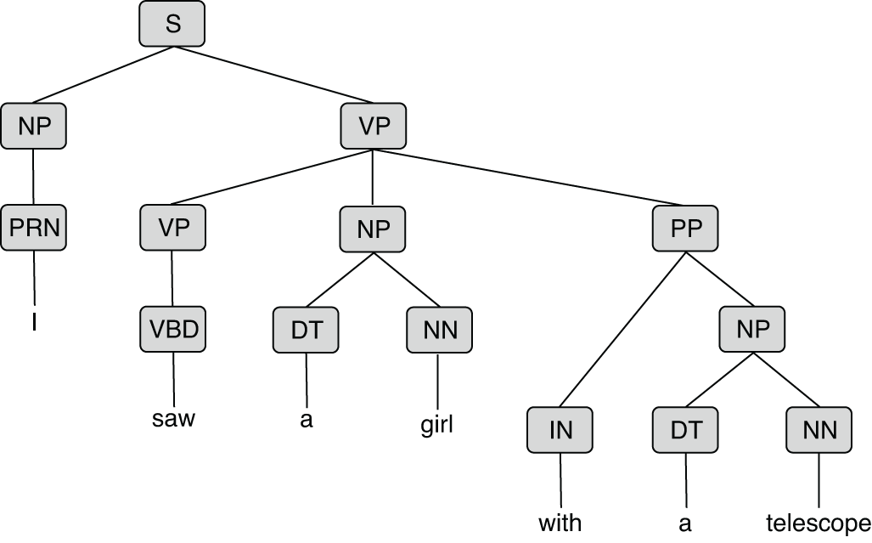
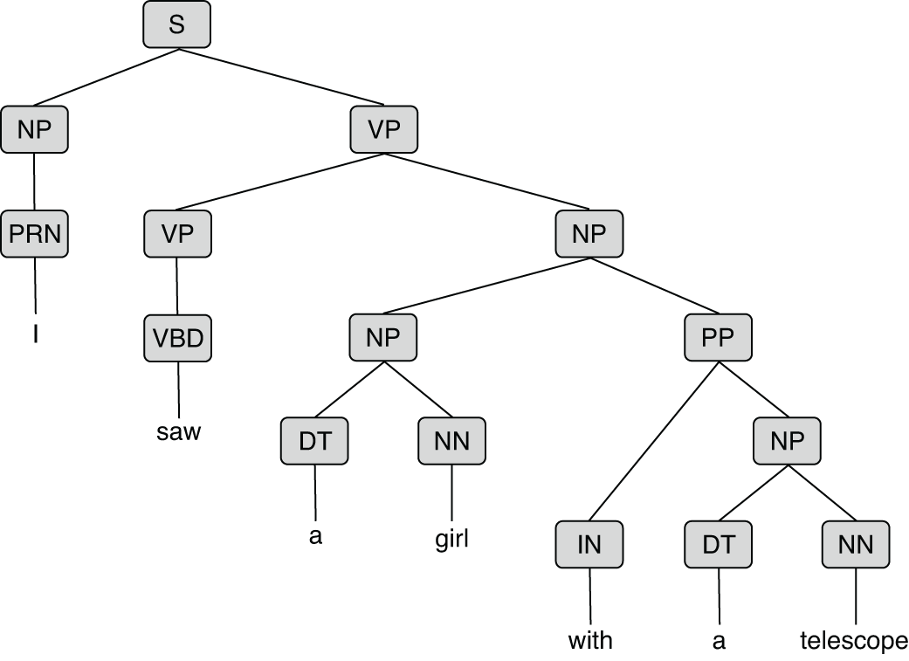
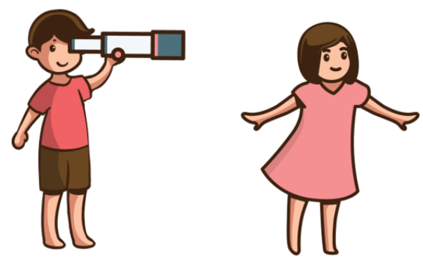

Introduction to NLP
Sentence-Level Syntactic Ambiguity
An preposition phrase (PP) can attached to a verb phrase (VP) or a noun phrase (NP).
Challenges in NLP
I saw a girl with a telescope.
I saw a girl with a telescope.

Slide 23
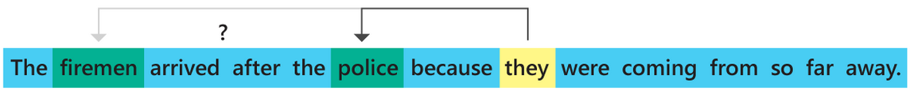
Introduction to NLP
Challenges in NLP
Coreference Ambiguity
A pronoun may refer to more than one preceding entity.
Notes:
plural [ˈplʊərəl]

Slide 24
Introduction to NLP
Challenges in Generative AI
Hallucinations refers to the generation of outputs that may sound plausible but are either factually incorrect or unrelated to the given context.
When did Leonardo da Vinci paint the Mona Lisa?
Leonardo da Vinci painted the Mona Lisa in 1815.
(Incorrect: The Mona Lisa was painted between 1503 and 1506, or perhaps continuing until 1517.)
Notes:
plausible [ˈplɔzəb(ə)l] 、
World Knowledge
Knowledge Carrier [ˈkeriər]

Slide 25


Slide 26


Slide 27
Large Language Model (LLM) Evolutionary Tree
(Source: Harnessing the Power of LLMs in Practice: A Survey on ChatGPT and Beyond)

Slide 28
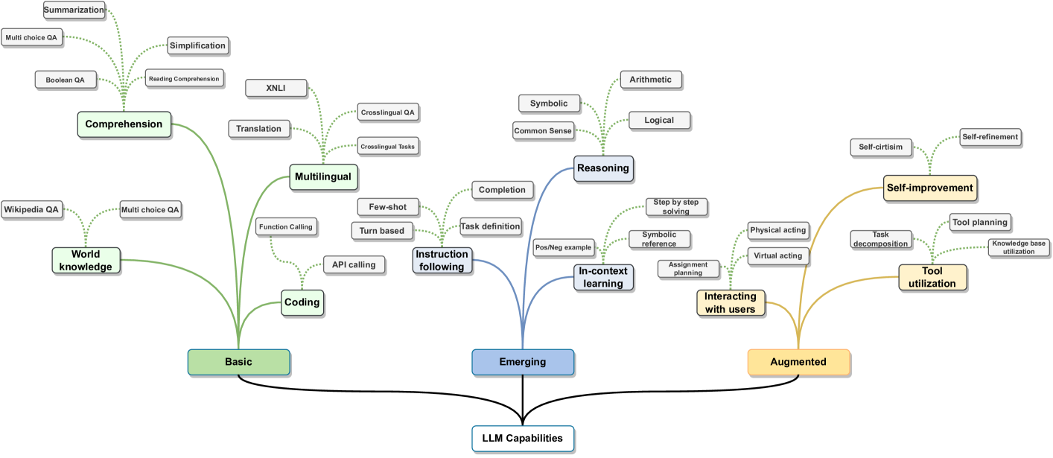
Large Language Model (LLM) Capabilities (Source: Large Language Models: A Survey)
Notes:
https://arxiv.org/html/2402.06196v2

Slide 29
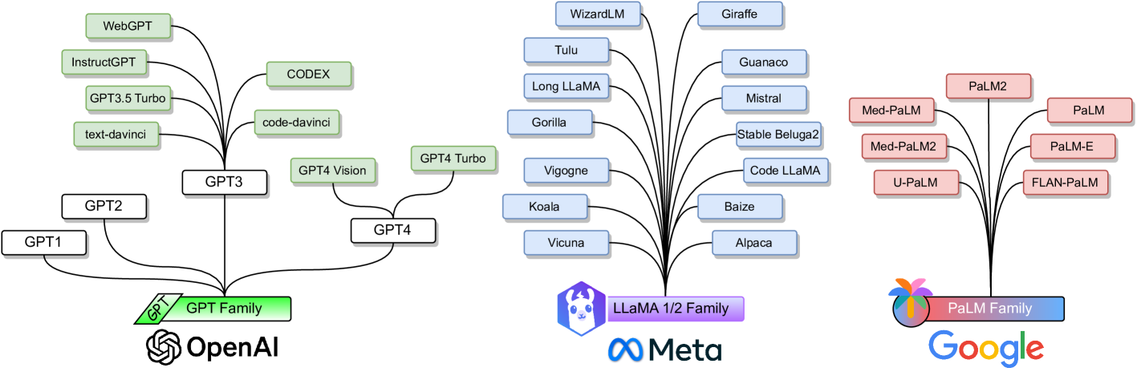
Large Language Model (LLM) Capabilities (Source: Large Language Models: A Survey)
Notes:
https://arxiv.org/html/2402.06196v2

